Slide 1
Ed 2500 Educational Issues
Alexandra Pletch
Kimberly Soutiere
Andrea Ziel

Slide 2
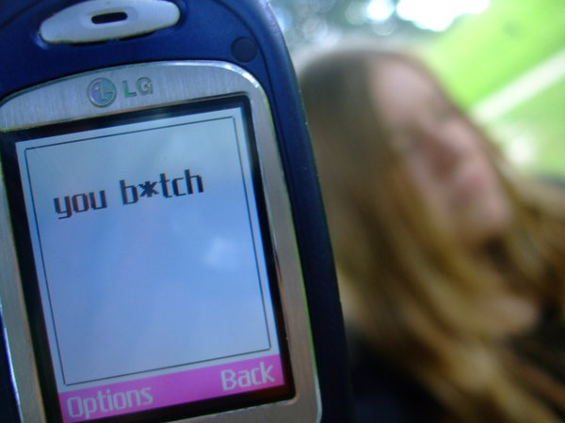
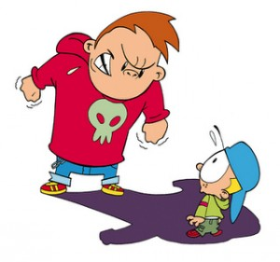
Bullying
Physical
Cyber
Emotional
Recognize
Know how to handle it
It in the
Classroom

Slide 3
What Is Bullying?
“A hurtful action carried out repeatedly over time.” (Froschl, Sprung, & Hinitz, 2005)
“Bullying is a way of treating people that is mean and hurtful. People who bully are not bad people, their behaviour is what’s bad. A person can learn to stop acting like a bully.” (Beane, & Fox, 2009)

Slide 4
Who’s an Expert?
Izzy Kalman
Parents
Teachers
http://chickensoupfortheterroristsoul.blogspot.ca/2012/02/chicken-soup-with-izzy-kalman-again.html

Slide 5
Classroom Community
“Healthy families and communities give individuals the experience of a life that extends beyond selfish interests… They combat personal insecurity with a simple, ancient message: “You are not alone.” When people are part of an effectively functioning community, they feel responsible in a way that isolated individuals never can.”
~ John W. Gardner, “National Renewal” a speech given for the National Civic League, found on page 73 in Barbara Coloroso’s the bully, the bullied, and the bystander

Slide 6
Activity: Compliment Cards
Examples:
Kids enjoy being with you
You are a good Role model
You always treat others with respect
You are so dependable
You have wonderful ideas

Slide 7
“As teachers it is our responsibility to create atmospheres where the students can feel safe and learn to there greatest potential” (Gleason 2011)

Slide 8
Bullying in School: Kick a Ginger Day
When teasing turns to harassment
Zero – Tolerance policies
Document actions the day they occur as a liability precaution
http://www.youtube.com/watch?v=EBOjl8lG9GI

Slide 9
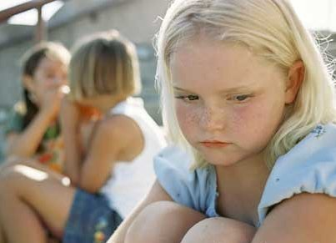
Activity: What Would You Do?
The teachers expressed that they participate in workshops, but there is little stimulation training, it is a lot of reading and being told to try different and new techniques in their classrooms. (Gleason 2011)

Slide 10
Bullying isn’t a fun experience, but it’s a learning experience on how to deal with difficult people.

